Slide 1
NIL and Competitive Balance
Abyan Nawaz, Beckett Sanderson, Vidit Shah

Slide 2

Competitive Balance
- Who cares?
- Match uncertainty
- St. Dev of Win %
Notes:
Who cares?
Think of NCAA as market and colleges as firms
Success in market is winning so teams hoarding winning have control of market
Student athlete
To maximize your personal success you want to win
If only a few teams are winning they have power over you to make you go to their school
If league gets more competitive balance -> more teams winning
Students have the power back to have more choice on where they go to school
How measure?
Stems from idea that spectators prefer match uncertainty
How measure match uncertainty?
St. Dev of Win %
Closer to 0 = more competitive balance

Slide 3
Timeline
2014 - CFP
2021 - NIL
2024 - Now
Notes:
Set the stage
Time series is 2014-2024
Hope to see change at 2021
Other team performance evaluation focused on as close to present as possible

Slide 4
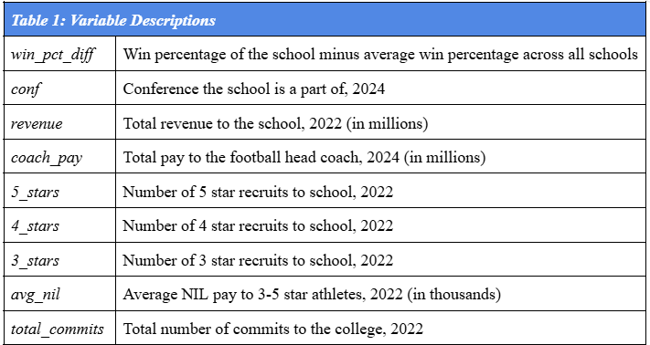



Data Sourcing
}
}
}
Notes:
Team performance data – Sports Reference
Economic data – USA today
Recruiting data – On3

Slide 5
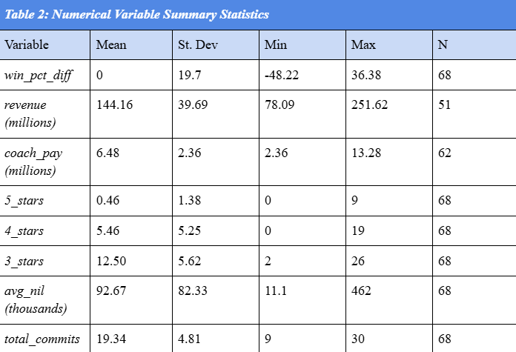
Summary Statistics
Notes:
There is still discrepancy in recruiting
Some schools have higher budgets and get more recruits
Not going to get to perfect competition of firms (schools in this case), just hoping to improve
Resources are a bit different between schools
Missing economic data
N is lower than 68 for data on coach pay and revenue
Data limitations transition

Slide 6
Data Limitations
Missing Data
Proxies
- Financial data reporting
- NIL competition
- Head coach pay
- Win % context
Notes:
Missing data
Some schools are private and simply keep revenue data locked up
We have most
NIL
Teams are in competition – getting information on what another team is paying a player lets you offer them more
No standardized contracts so no standardized data
A lot of money comes from sponsorships of those who are fans of the school
Proxies
Difficult to evaluate abstract concepts of sports so we have to use proxies for those concepts
i.e. Head coach pay as proxy for a school’s investment in the football program
a team could invest in the coach, but not the rest of the team
Win percentage as the measure of competitive advantage
Other context such as the win margin, the skill of the teams they are playing
Ex: two teams have the same win % but one played much harder competition
the one who played harder competition would be the better team competitively
Look at other catch-all performance metrics
Simple Rating System

Slide 7
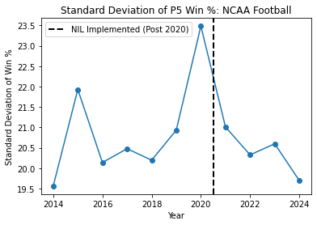
Competitive Advantage Over Time
- Closer to 0 = more balance
- Representative?
Notes:
Working with win % for now – first look at data
Walk through line chart
Representative
General trend of going down
Spike in 2020 – outlier or representative of the upward trend away from balance before NIL
More data from upcoming years will help settle debate

Slide 8
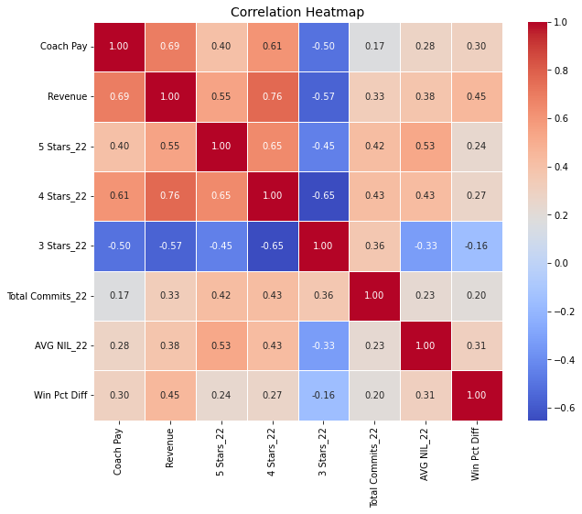
Numerical Variable Relationship
- All variables positive correlation…
- …except 3 stars
Notes:
Bottom row most important with connection to win % differential
All positive correlation but 3 stars
Idea of teams unable to compete for highest level of talent (4 and 5 star) may focus on 3 star instead
Point of exploration for model
If quantity and quality of recruits matters and NIL helps spread those recruits to more schools
-> then NIL would help create competitive balance

Slide 9
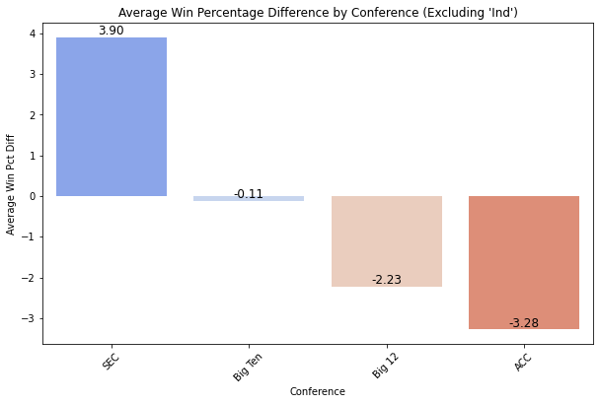
Categorical Variable Relationship
- Conference and win % relationship
Notes:
Categorical variable of Conference
There is a relationship
Lends more weight to win % in a harder conference like SEC may mean more than an easier one like ACC

Slide 10

Contributions
- Competitive balance matters
- St. Dev of Win % decreasing
Notes:
Comp balance matters
Gives power back to athletes to have more range of choices
St Dev of win %
Trend of our competitive balance measure decreasing towards 0 is promising for research
Further exploration will determine its final significance

